Slide 1
Magnetic circuits

Slide 2
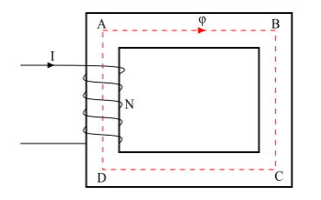
MAGNETIC CIRCUITS
A magnetic circuit is defined as a closed path followed by the magnetic flux.
Consider a coil of N turns wound on an iron core (see the figure). When an electric current I is passes through the coil, magnetic flux (ψ) is set up in the core. This magnetic flux follows a closed path ABCDA and hence ABCDA is the magnetic circuit.
In a magnetic circuit, the amount of magnetic flux in the core depends upon the current (I) and the number of turns (N). The product NI is known as the Magneto motive Force (MMF).
MMF=NI=Ampere−Turns
The opposition offered by the magnetic circuit to the flow of magnetic flux is known as reluctance (S) of the magnetic circuit.

Slide 3
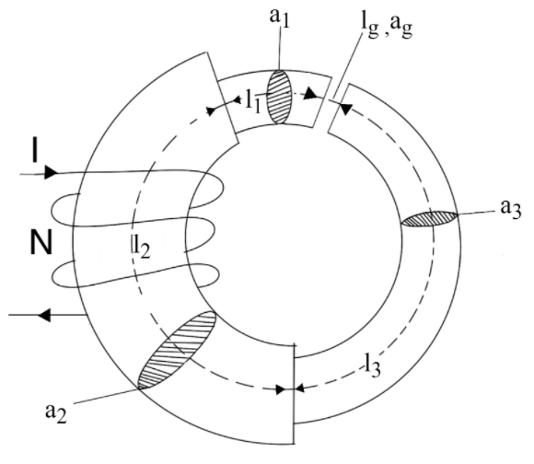
SERIES MAGNETIC CIRCUITS (composite magnetic circuits)
When the same magnetic flux ψ flows through each part of the magnetic circuit, then the circuit is called as series magnetic circuit.
Consider a composite series magnetic circuit (a series magnetic circuit that has parts of different dimensions and materials is called a composite series magnetic circuit) consisting of three different magnetic materials of different relative permeability.
Each part of this series magnetic circuit will offer reluctance to the magnetic flux ψ. Since the different parts of the magnetic circuit are in series, the total reluctance is equal to the sum of reluctances of individual parts.

Slide 4
SERIES MAGNETIC CIRCUITS (composite magnetic circuits)

Slide 6
Example: A magnetic circuit consists of an iron ring of mean circumference 80 cm with cross-sectional area of 12 cm² throughout. A current 0f 2A in the magnetising coil of 200 turns produces a total flux of 1.2 mwb in the iron. Calculate :
(i) the flux density in the iron
(ii) the absolute and relative permeability's of iron.
(iii) the reluctance of the circuit.

Slide 7
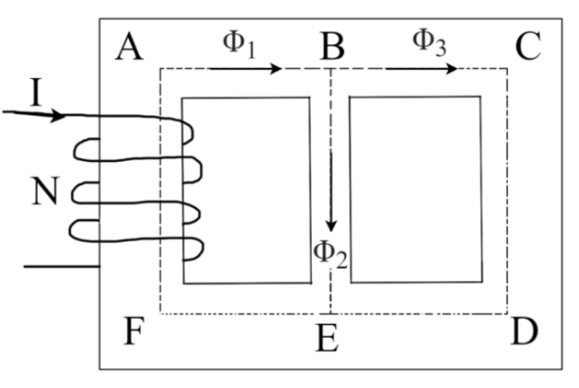
Parallel Magnetic Circuit
A magnetic circuit which has more one path for the magnetic flux is called as parallel magnetic circuit.
Consider a coil of N turns wound on limb AF carries an electric current of I amperes. The magnetic flux φ1 set up by the coil divides at B into two paths i.e., φ2 along BE and φ3 along BCDE.
Therefore, the total flux is,
φ1=φ2+φ3
Consider, S1 = reluctance of path EFAB S2 = reluctance of path BE S3 = reluctance of path BCDE
Total MMF=MMF for path ABEF+ MMF for path BE or BCDE
⟹Total MMF=φ1S1+φ2S2 or Total MMF =φ1S1+φ3S3
φ2S2=φ3S3 they are parallel

Slide 8
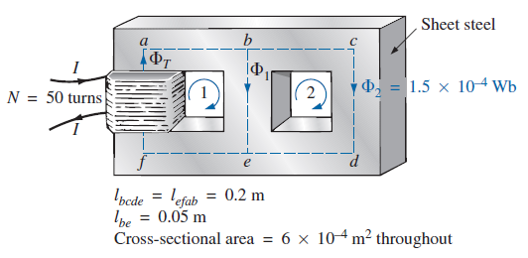
Example: Determine the current I required to establish a flux of 1.5x10^-4 Wb in the section of the core indicated in Fig. The relative permeability of the material is 1200.

Slide 11
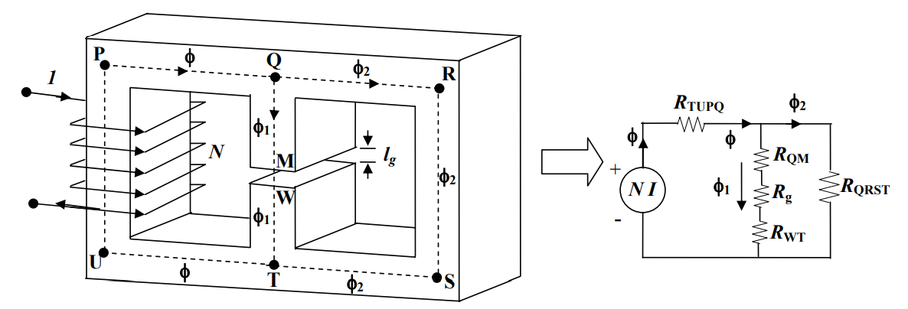
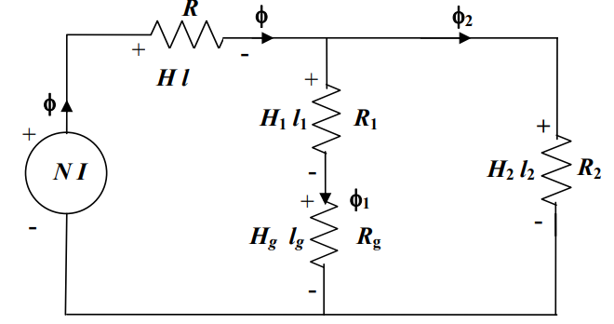
Series-parallel Magnetic circuits

